Slide 1
Welcome to Drawing_app.
In this document, we will explain the various functions on the website. First, please watch the attached video in the next slide.
All the complete information, including code and project documentation, can be found at the following link:
https://github.com/Lavi1212/Drawing_app_2

Slide 2
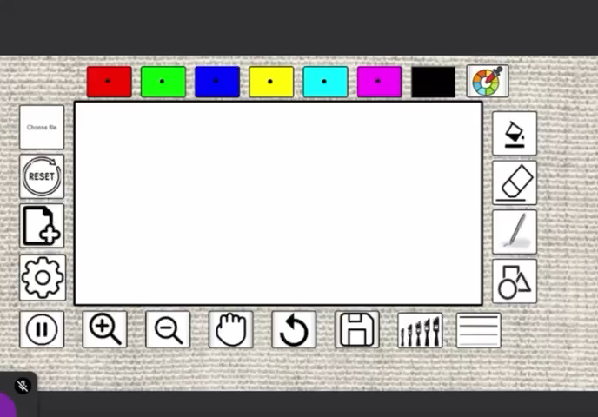

Slide 3
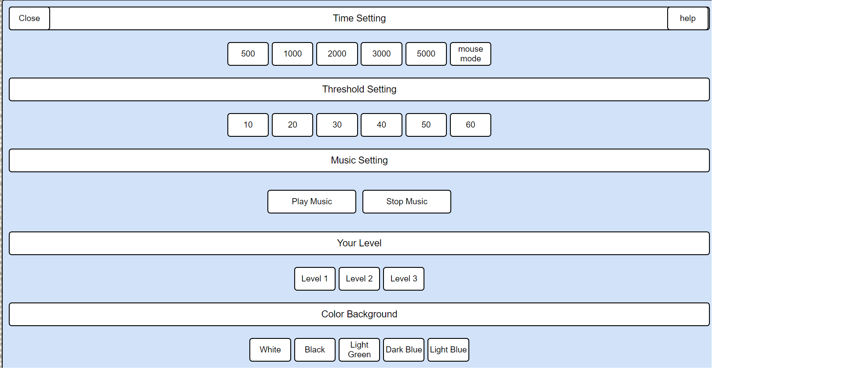
Let's explain these settings further:
For each click, there is an option to remain with the cursor (mouse or gaze focus) in the same place for a certain amount of time ('dwell click'). It is very important to note – even when using a regular mouse, a dwell click can be performed.
The time settings determine how long to stay in this place in milliseconds. If it is 'mouse mode', a physical click on the mouse is required to allow a click. Default: 2000.
The 'Threshold' settings will determine the area on which you need to stay. The higher the value, the larger the area, making it easier to perform a click. Note that too large an area may result in accidental clicks. Each user should find what works best for them. Default and recommended: 40.
If it is a button, you need to stay for the chosen amount of time within the button area.

Slide 4
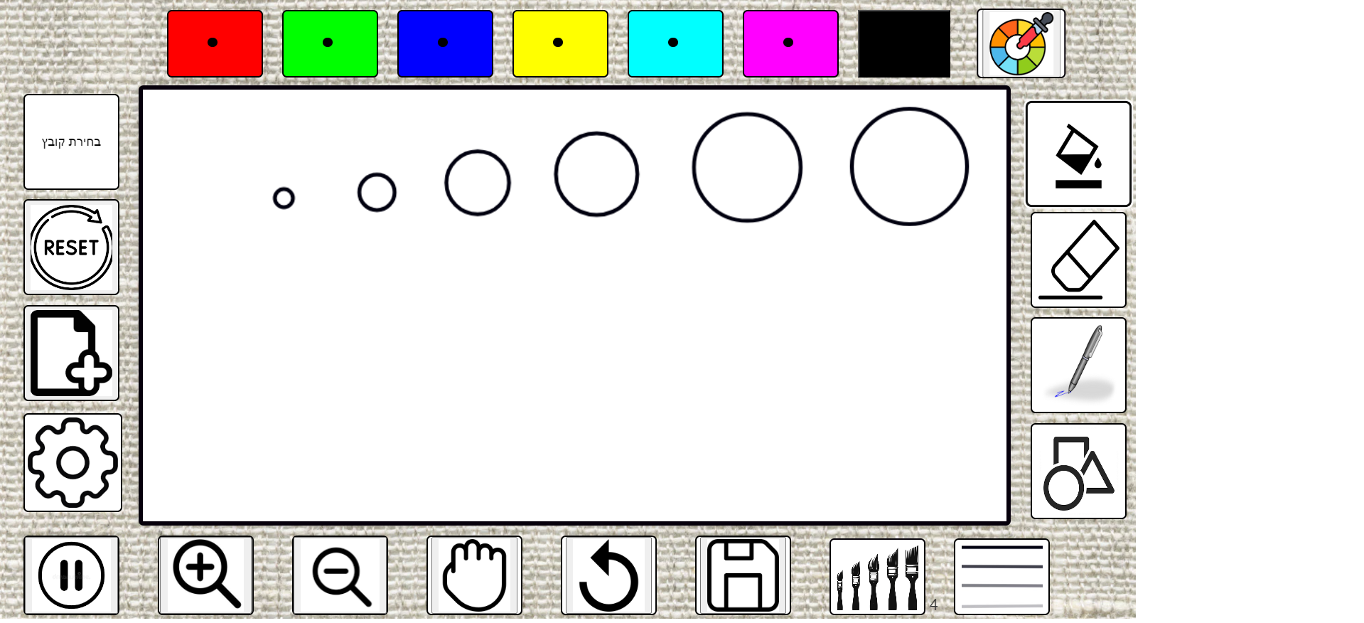
Threshold =
10
Threshold =
20
Threshold =
30
Threshold =
40
Threshold =
50
Threshold =
60
These are the sizes for each Threshold. You can adjust the settings with the mouse under the color fill option to get a good indication.
Good information: The numbers represent the number of pixels in the radius of the circle.

Slide 5
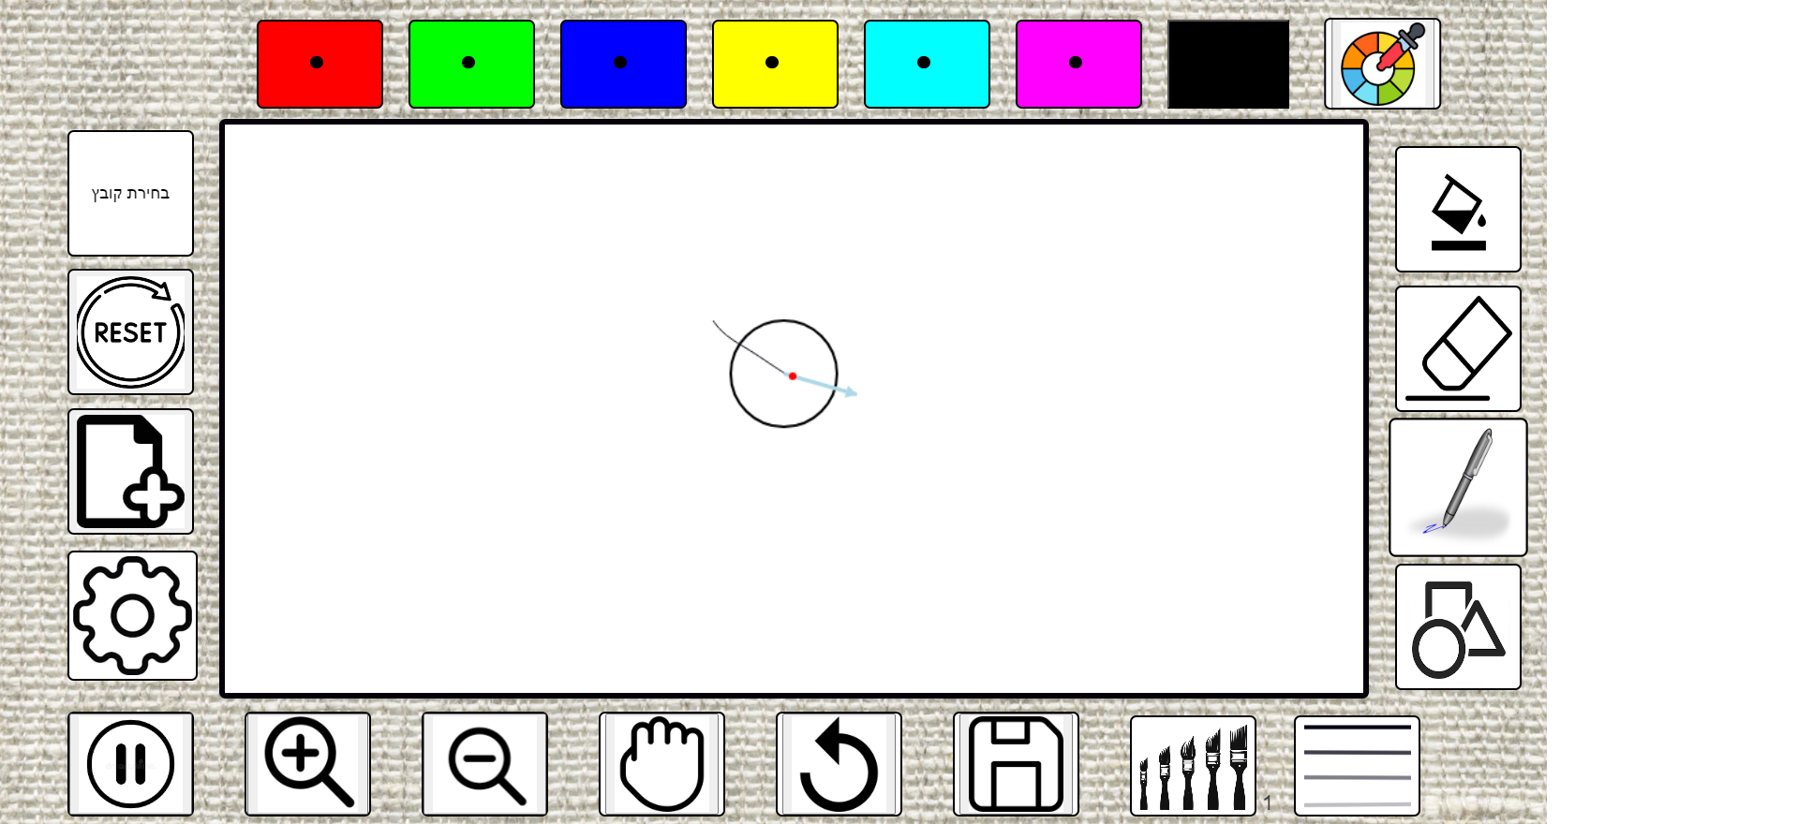
Compass Mode – Note, this is an option for advanced users for freehand drawing!
It is highly recommended to first work with a mouse to better understand how it works.

Slide 6
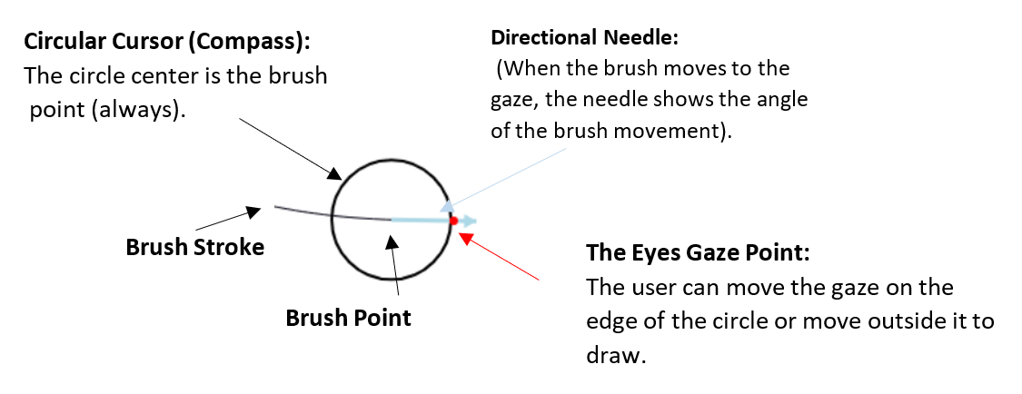
Compass Mode – Continued Explanation:
Compass Mode consists of a circle and a directional needle, where the center of the circle is the brush point. The directional needle points from the brush point (the center of the circle) to the point of view, indicating the direction of the brush movement.
The radius of the circle is slightly smaller than the Threshold defined by the user.
The brush will start drawing only when the gaze is outside the circle or directly on the circle itself. Only then brush movement will occur.
For further details on this mode, you can refer to the full description in the project documentation on pages 8-10

